Slide 1


AWS Key Management Service
Cloud Encryption & Strategic Key Management at Scale
Cloud Security Architecture
Presented By Vignesh Adlagatta

Slide 2





SESSION AGENDA
Foundations
AWS KMS Core
Operations
Introduction to encryption concepts and cloud data challenges.
Features, architecture, and the mechanics of envelope encryption.
Implementation workflow, integrations, and security best practices.

Slide 3

01
The Fundamentals of Encryption
Securing data in the modern cloud landscape

Slide 4

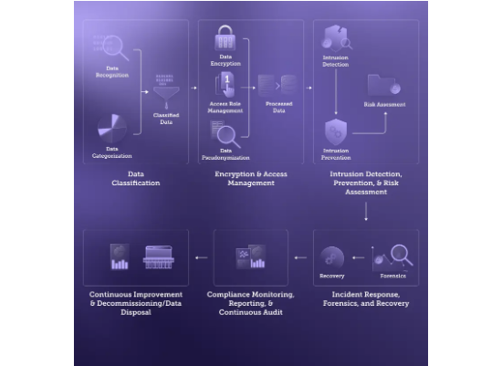
DEFINING DATA ENCRYPTION
Encryption is the process of converting plaintext information into ciphertext using mathematical algorithms and a secret key.
Confidentiality: Only authorized parties can read data.
Integrity: Detect unauthorized changes to information.
Authenticity: Verify the identity of the sender.
Compliance: Meet regulatory standards (GDPR, HIPAA, PCI-DSS).

Slide 5


ENCRYPTION MODALITIES
Symmetric
Asymmetric
At Rest / Transit
Same key for encryption and decryption. High speed, ideal for bulk data.
Public/Private key pairs. Secure key exchange and digital signatures.
Protecting data stored on disks vs. data moving across networks.

Slide 6
02
Introduction to AWS KMS
The heart of AWS security infrastructure

Slide 7

MANAGED KEY INFRASTRUCTURE
AWS KMS is a managed service that makes it easy for you to create and control the cryptographic keys used to protect your data.
FIPS 140-2 Level 2: Hardware-backed security modules (HSM).
Highly Integrated: Native support for 100+ AWS services.
Scalable: Handles billions of requests per day.
Auditable: Every usage is logged in AWS CloudTrail.

Slide 8




STRATEGIC VALUE PROPOSITION
Auto Rotation
Cost-Effective
HSM Protection
Lower the blast radius by automatically rotating keys annually.
$1 per KMS key per month. Pay only for what you use.
Keys are generated and used within specialized hardware.

Slide 9
03
Core Concepts & CMKs
Understanding the building blocks of KMS

Slide 10



HIERARCHICAL KEY MODEL
KMS Keys (CMKs): Logical representation of a master key. Used to protect Data Keys.
Data Keys: Encryption keys used to encrypt large datasets directly.
Key Policies: Resource-based policies that control access to KMS keys.
Grants: Temporary delegation of permissions to other AWS principals.

Slide 11
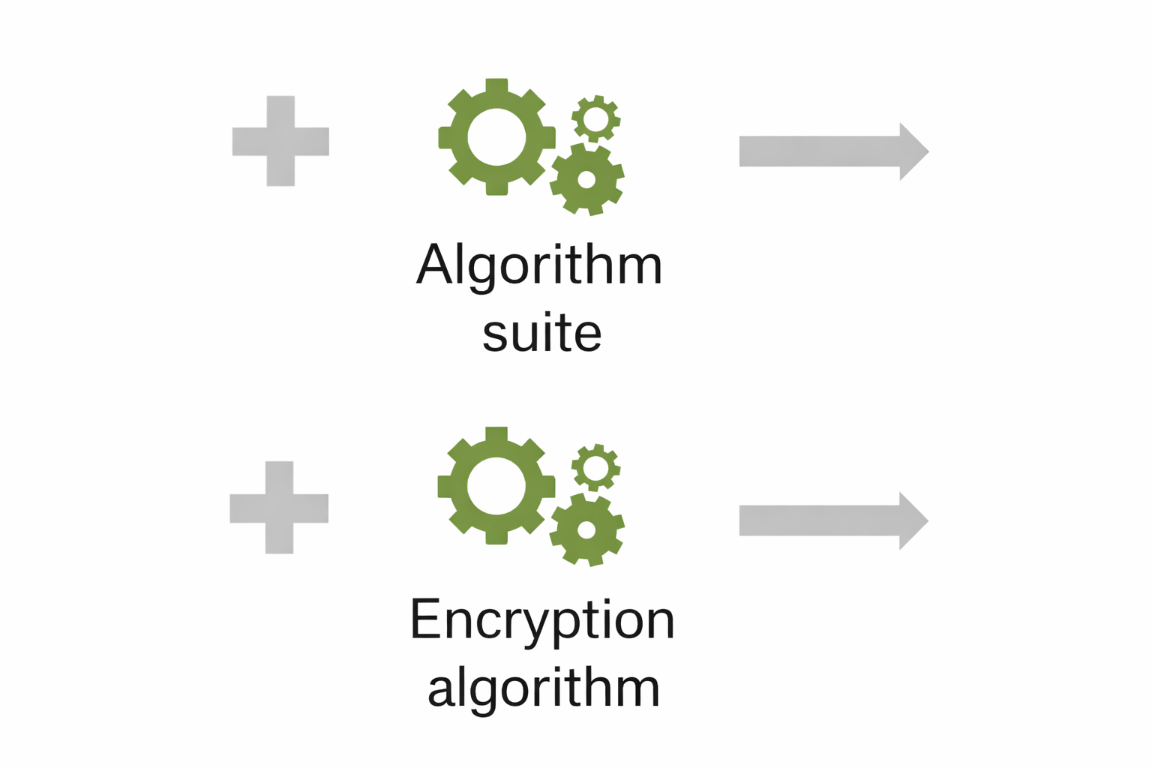
ENVELOPE ENCRYPTION
The method of protecting data by encrypting it with a Data Key, and then encrypting that data key with a KMS Master Key.
Performance: Large data is encrypted locally with symmetric keys.
Security: Data keys are stored alongside encrypted data in an encrypted format.
Efficiency: No need to send massive datasets to KMS over the network.

Slide 12
04
Architecture & Workflows
How encryption happens in real-time

Slide 13

SYSTEM ARCHITECTURE
Request
Generate
Encrypt
Storage
App requests a Data Key from KMS using a CMK ID.
KMS sends Plaintext Data Key + Encrypted Data Key.
App encrypts data locally; deletes Plaintext Data Key.
Encrypted data + Encrypted Data Key are stored.

Slide 14
05
AWS Service Integrations
Seamless protection across the ecosystem

Slide 15




UNIFIED KEY MANAGEMENT
Amazon S3
Amazon EBS
Amazon RDS
Server-side encryption for buckets and objects.
Encrypted volumes and snapshots for EC2.
Encryption at rest for databases and backups.

Slide 16
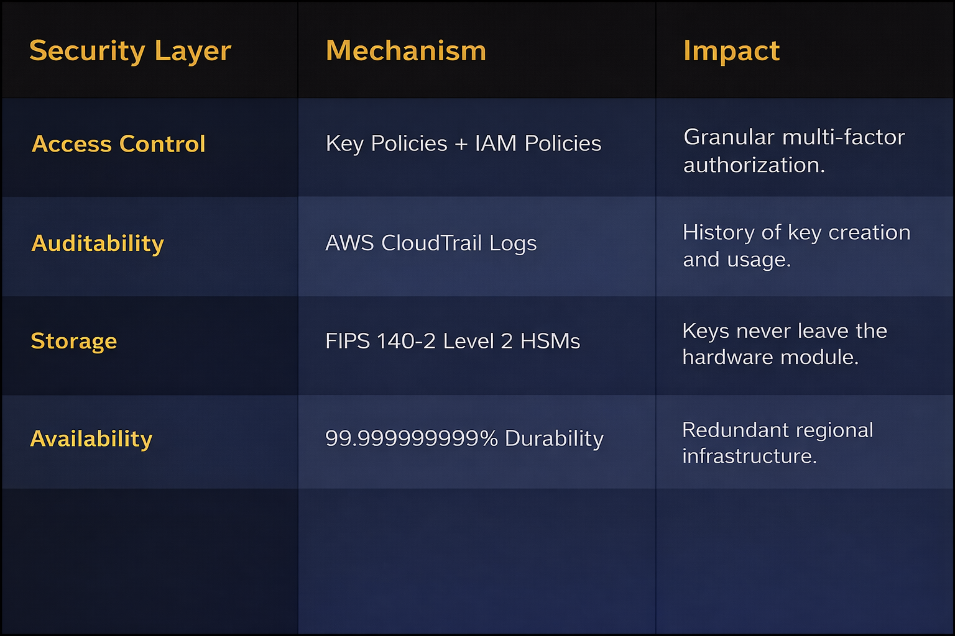
KMS SECURITY MODEL

Slide 17
06
Best Practices & Costs
Optimizing for security and performance

Slide 18

SECURITY GOVERNANCE
Principle of Least Privilege: Segregate administrators from key users.
Enable Rotation: Use AWS Managed rotation for security hygiene.
Region Strategy: Multi-Region keys for global compliance/DR.
Monitoring: Alert on "ScheduleKeyDeletion" events immediately.

Slide 19
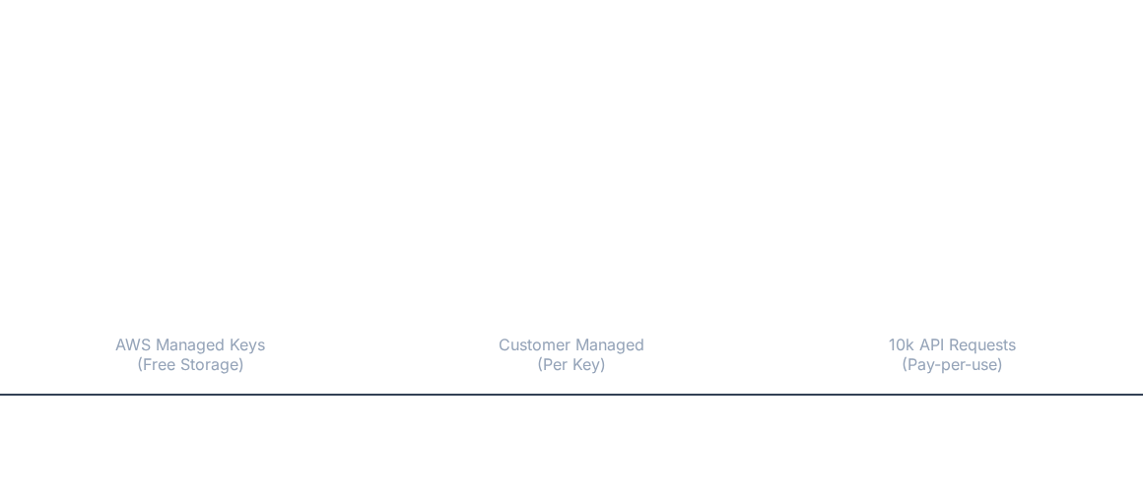


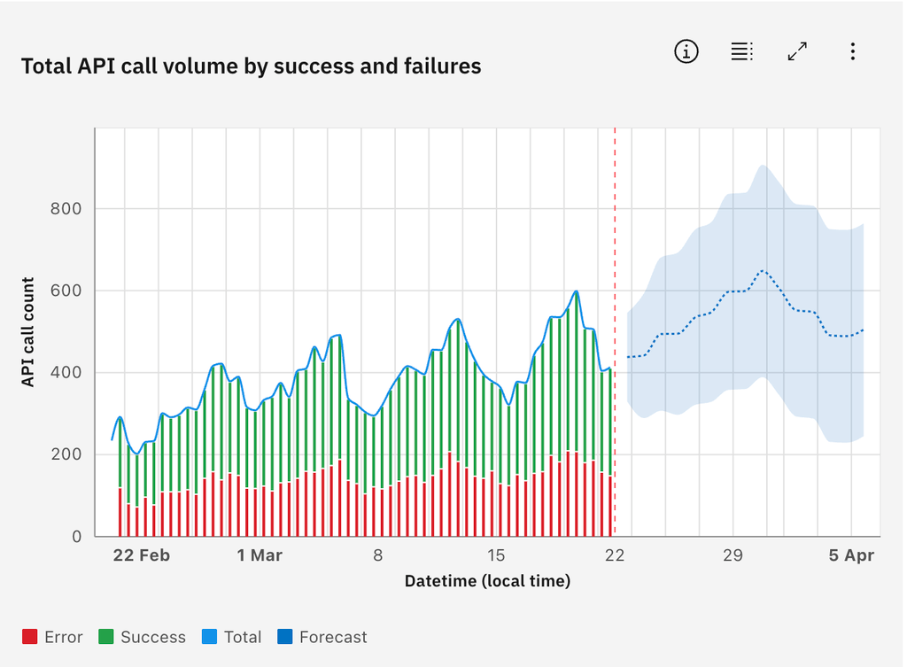
KMS COST EFFICIENCY
*Use AWS Managed Keys whenever possible to eliminate per-key storage costs.

Slide 20
Q&A
Secure your cloud journey with strategic key management.
For more details, visit: aws.amazon.com/kms
Follow AWS Security Best Practices Whitepapers

Slide 21






IMAGE SOURCES
https://conceptdraw.com/a3130c3/p19/preview/640/pict--aws-kms-aws-security,-identity-and-compliance---vector-stencils-library.png--diagram-flowchart-example.png
Source: www.conceptdraw.com
https://cdn.prod.website-files.com/63e21dce115cee384ab9eeca/68cbd087750df3344ac51fa2_Cloud%20data%20security%20guide%20visual%204.webp
Source: www.sentra.io
https://static.vecteezy.com/system/resources/previews/035/728/677/non_2x/3d-security-shield-lock-check-mark-and-cloud-cyber-protection-3d-rendering-password-protected-icon-for-mobile-applications-and-website-concept-illustration-vector.jpg
Source: www.vecteezy.com
https://cdn.hashnode.com/res/hashnode/image/upload/v1635198756845/mXf8rwGhU.png
Source: www.freecodecamp.org
https://static.vecteezy.com/system/resources/previews/015/286/163/non_2x/abstract-background-digital-concept-cybersecurity-shield-anti-virus-malware-spy-protection-cyber-theft-security-on-a-blue-black-background-vector.jpg
Source: www.vecteezy.com
https://img.freepik.com/premium-vector/exploring-global-computer-network-infrastructure_18660-6632.jpg
Source: www.freepik.com

